Slide 1
Contra Project
Sprint 4 Presentation
Ethan Moore: ethan.moore416@topper.wku.edu
Aman Patel: aman.patel689@topper.wku.edu
Will Craddock: will.Craddock@topper.wku.edu

Slide 2
Project overview and goals
We are creating the Contra game.
Contra is a run and gun game created in 1987.
Theme of this game is humans fighting aliens.
Game has eight stages in the original version, two main characters and about ten different monsters/bosses.
Contra was published on few different platforms after the first success on arcade version.
Our goal is to create a game, maintain the documentation and other research materials we used for creating the game.

Slide 3
Functional requirements
Main character will be controlled by keyboard.
Users will be able to create multiple players and different accounts.
We will implement login systems for users.
We will also create a splash screen which login prompt and registration prompt.

Slide 4
Non- Functional Requirements
We will use Unity game engine and development environment to create this game.
We will try to create complete replica of the game but fewer stages.
We will use pre-developed images, audio and some artwork from the original game.
We will be developing source codes for this project.
We will use database to store login information and scores of the players.
We will gather and optimize Performance metrics.
We will gather and optimize Security metrics.
We will gather and optimize User Interface metrics.

Slide 5
Approach to the project
We have played the game
All of us have experience in some aspect of creating this project.
Aman has experience in database and language and C#
Ethan has experience in Unity and C#.
Will has experience in Unity and database.
Group meets twice every week, and decided to meet outside of scheduled time if necessary.
We spend 9 hours each member per week for this project.
Group meets with client once every week.
Waterfall software process model.

Slide 6
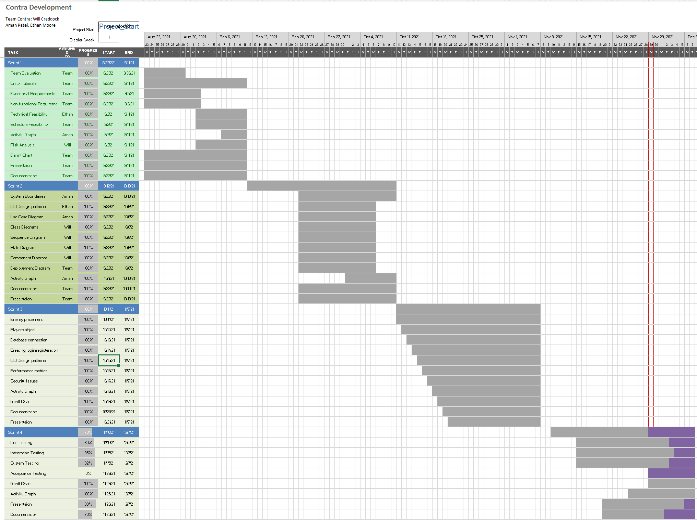

Slide 7
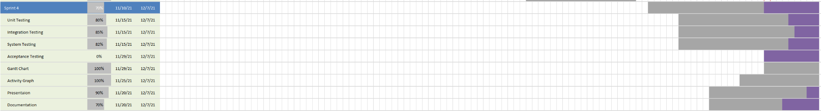
Gantt Chart

Slide 8
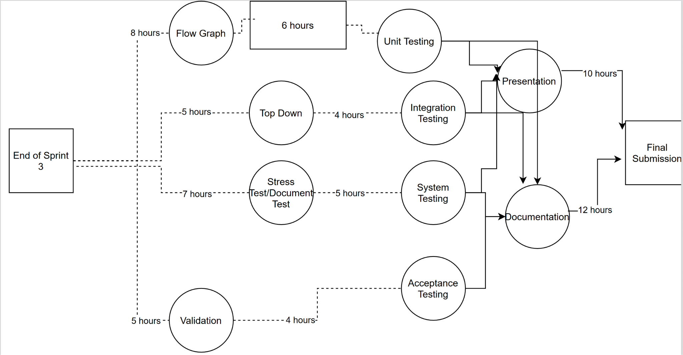
Activity Graph

Slide 9
Technical resources (hardware/software)
Hardware architecture details
We are aiming for Contra to run on a typical Desktop or Laptop running a x86 cpu architecture.
Software architecture details
Front-end frameworks/GUI
The front-end will use Unity version 2020.3.17f1 LTS.
Back-end frameworks/OS
The back-end framework we will use for the database is phpmyadmin and mysql
The database will be locally hosted on the users computer

Slide 10
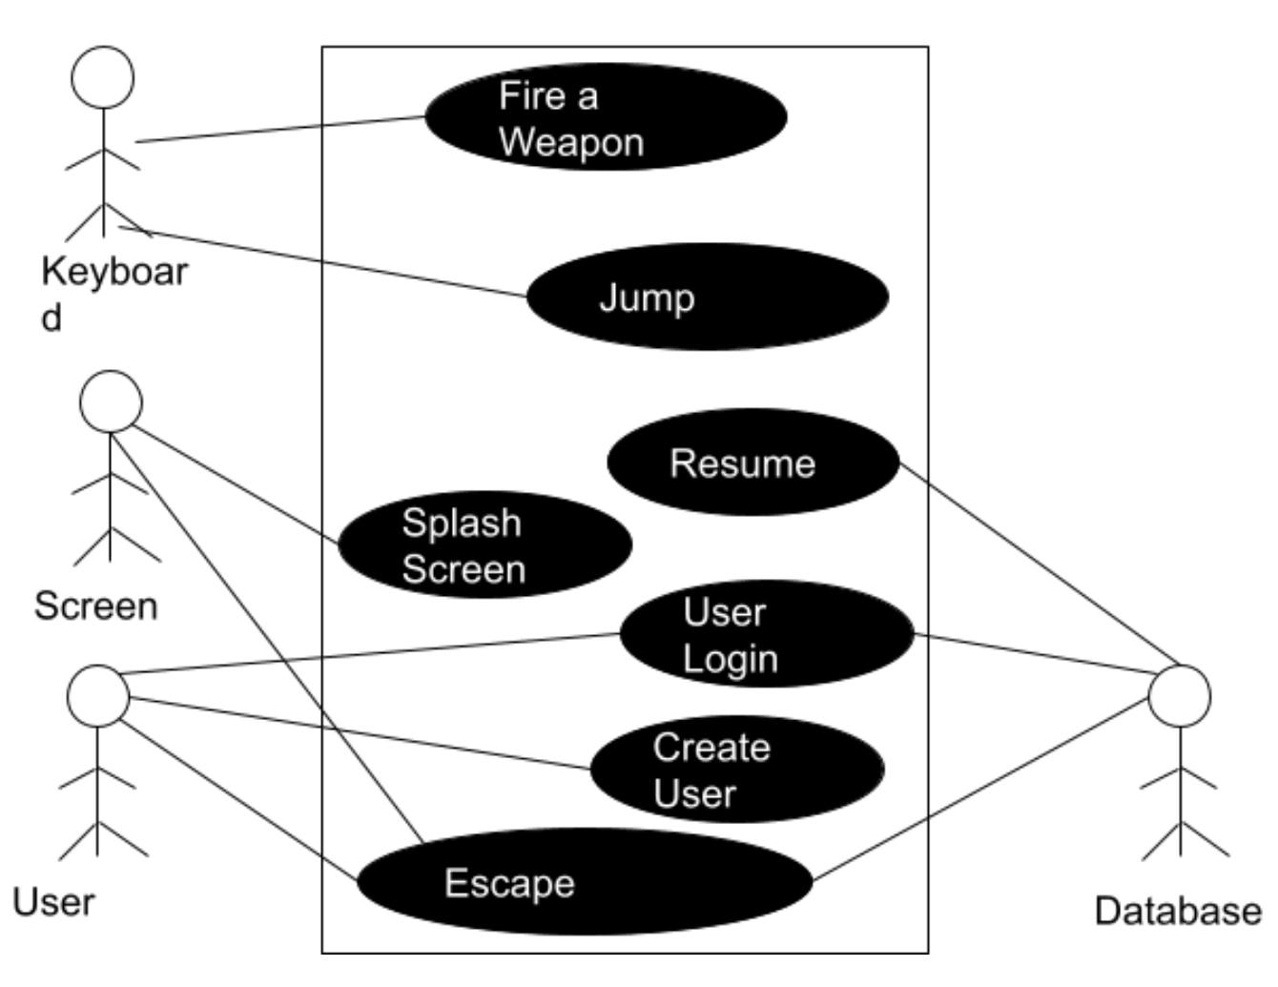
Behavioral UML Use Case Diagrams

Slide 11
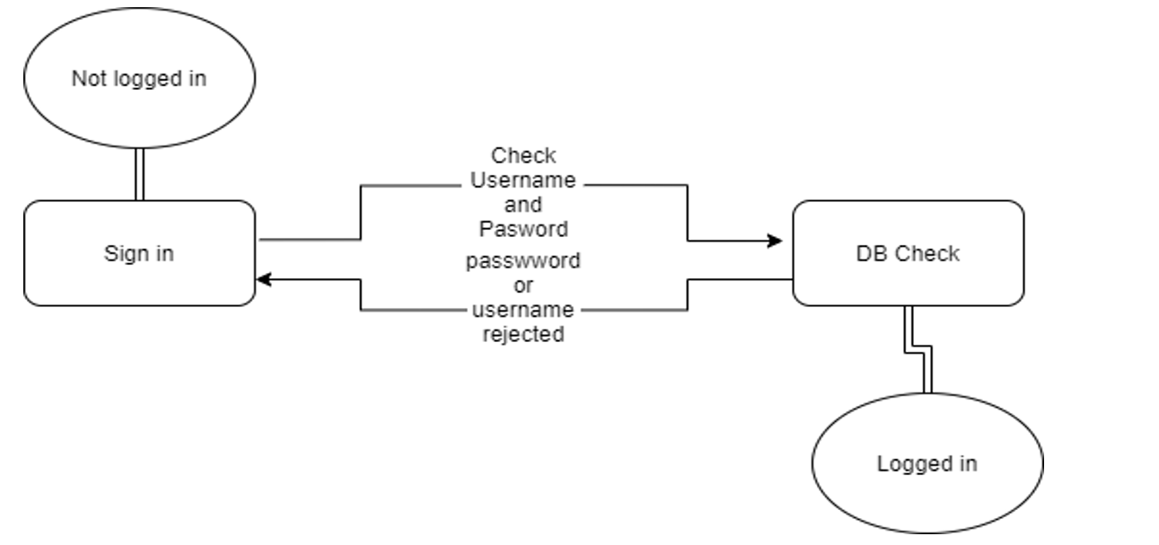
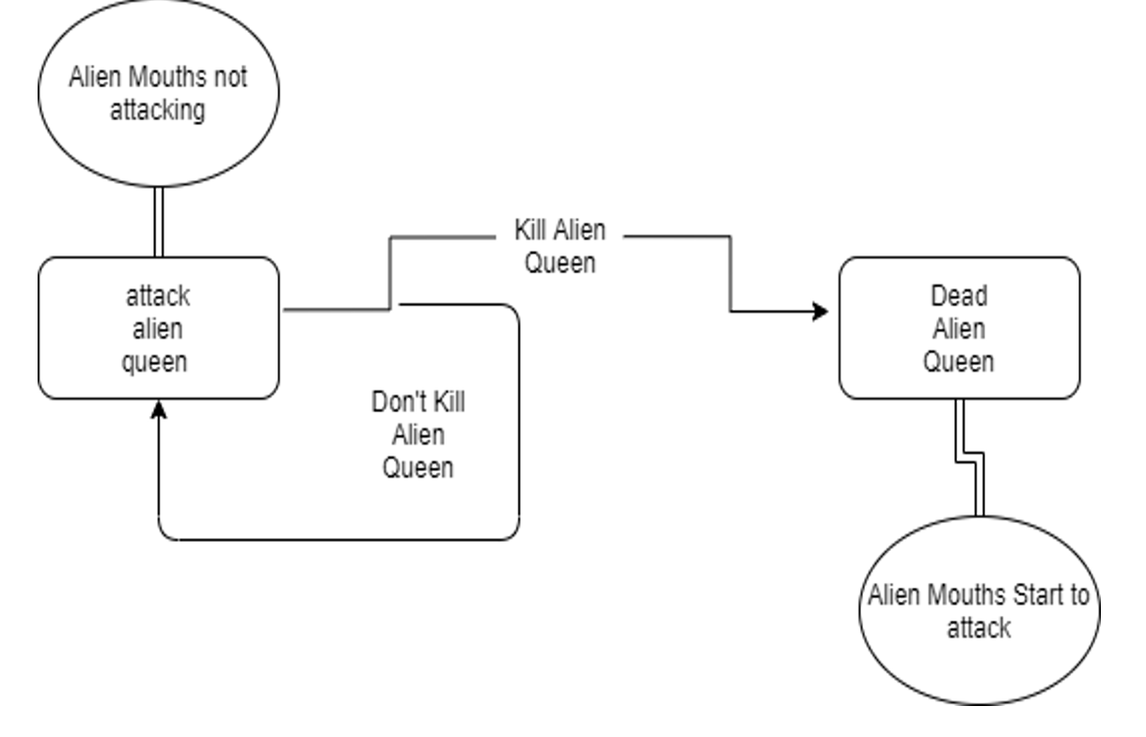
Behavioral UML State Diagrams

Slide 12
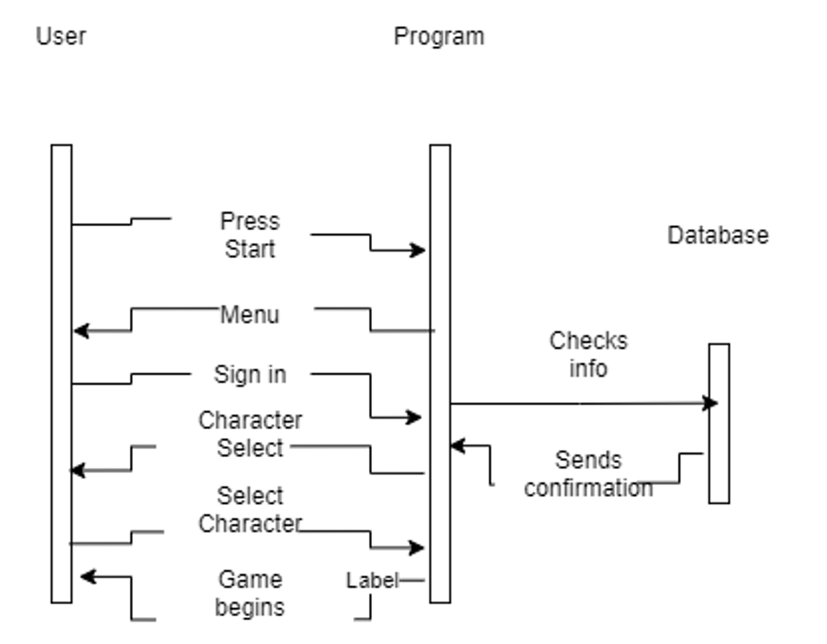
Behavioral UML Diagrams: Sequence

Slide 13
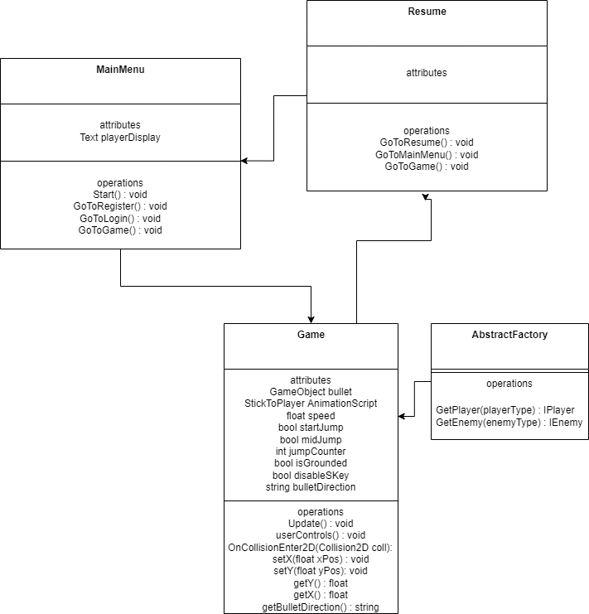
Structural UML Diagrams:Class diagrams

Slide 14
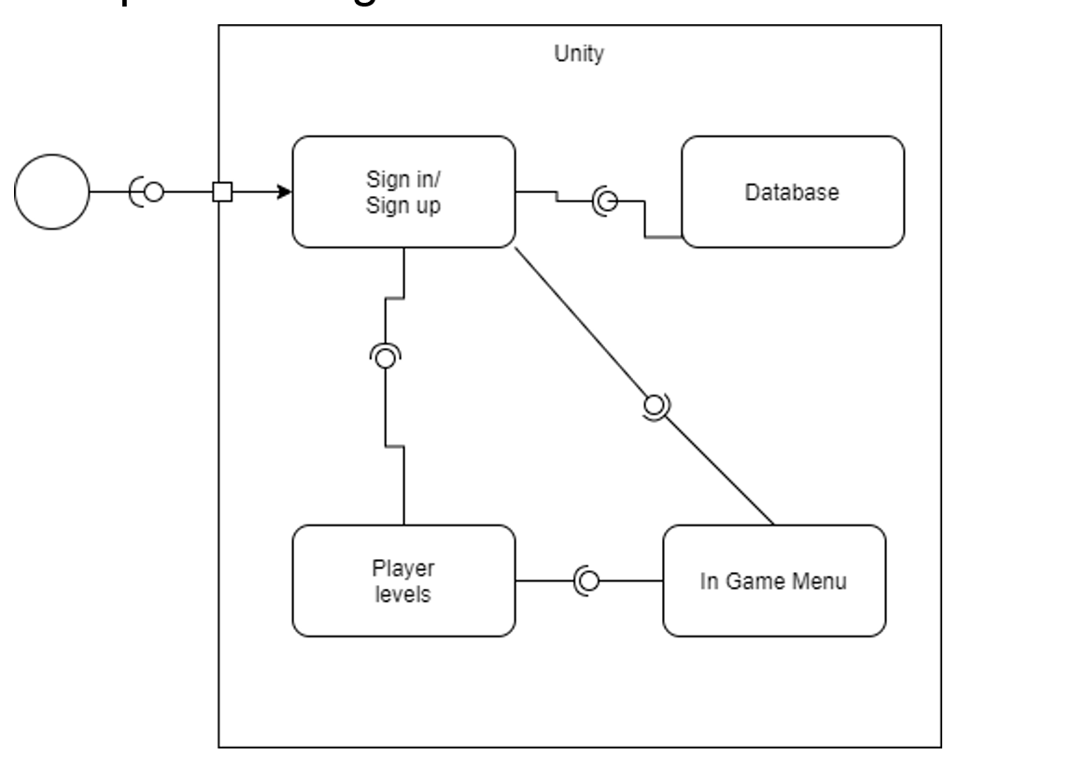
Structural UML Diagrams:Component diagrams

Slide 15
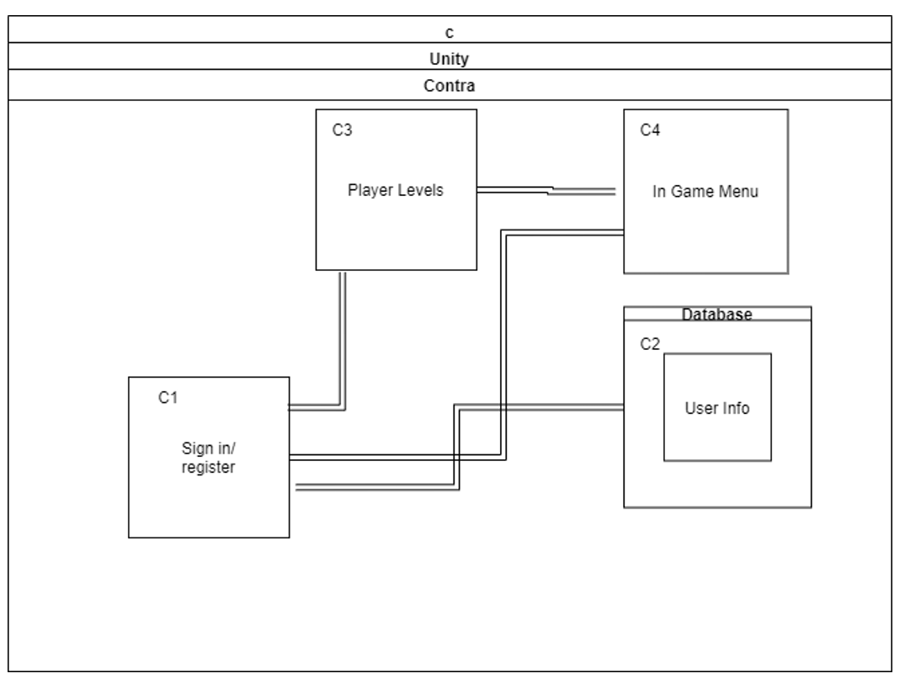
Structural UML Diagrams: Deployment Diagrams
p

Slide 16
Approach to security issues
Security Requirements
Authenticate user before login
Secure connection to database
Authenticate for user in every scene to track unauthorized user
Not everybody can see anyone’s scores

Slide 17
Security Issues mitigated
Hashing user information - Data Security
The data stored in the local MAMP database hashes the password
Code review - Code Security
We have gone through a comprehensive code review to remove excess code and update functionality to be more streamlined.
LTS Unity Version - Outdated Packages
The unity version were using is 2020.3.17f1 LTS which is a long term support version.

Slide 18
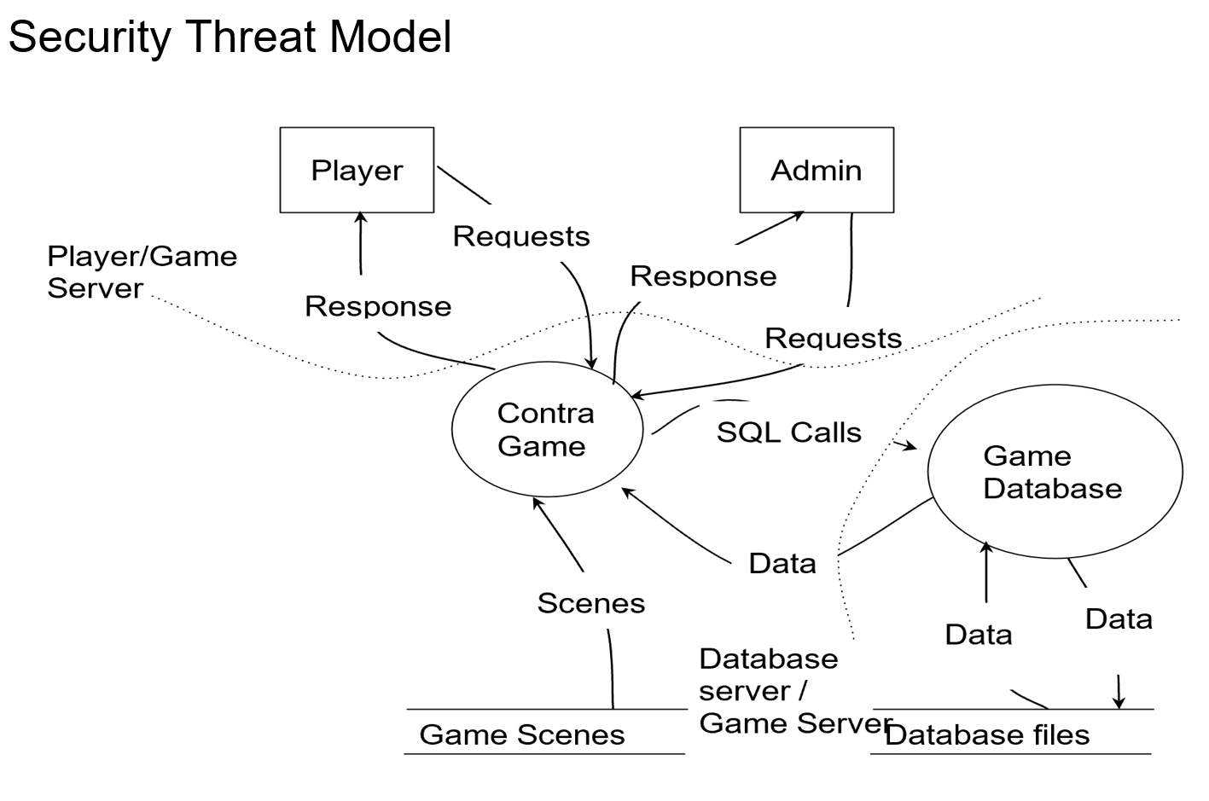
Security Threat Model

Slide 19
Approach to performance issues
Performance Requirements
System/Application Workload Analysis
According to our testing login page will use about 10 percent of the CPU, registration will use 15 percent of the CPU and actual game will use about 20 percent of the CPU.
Main Menu
Avg fps = 46.062043
Level 1
Avg fps = 47.1449802
Test Cases with Results (table, graph, etc.)
Synthetic Benchmarks
Other Time/Rate Performance Analysis
Hardware/Software Bottlenecks
Justified with gathered data

Slide 20
Performance Requirements
Minimize latency: To solve this problem we are using latest version of Unity game engine and hosting our database locally and writing the scripts in a way that the complexity if the functions/methods is minimum possible.
Reduce database lag: Our project is designed to use database for minimum period, in fact database is used in the beginning of the game to authenticate user/ to register a new account.
Reduce bottlenecks: We are taking the target system very seriously and designing our game accordingly to avoid bottlenecks between the user hardware and software.
Minimize database redundancy: Improve performance our goal is to reduce redundancy by implementing tables in the database that follow third normalization.
Careful game object design: Instantiating prefabs is far easier than instantiating gameobjects.

Slide 21
Hardware/Software bottlenecks
Reducing bottlenecks is also an important part of improving the performance of a software system. Bottlenecks means there is a gap between two processes or hardware pieces which result in slower performance. Here are some situations where our software might have bottlenecks.
● User hardware/operating systems are not taking advantage of the high-speed database we have to offer.
● Database server is not running as fast as php scripts are getting requests from the players/admin.

Slide 22
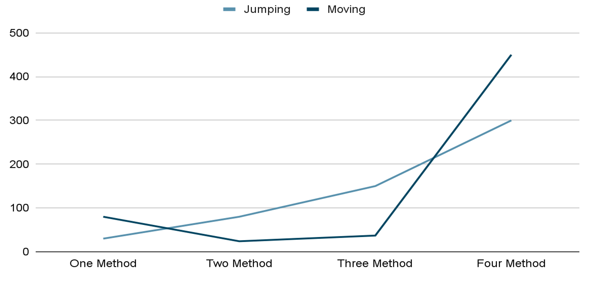
Jumping, Moving

Slide 23
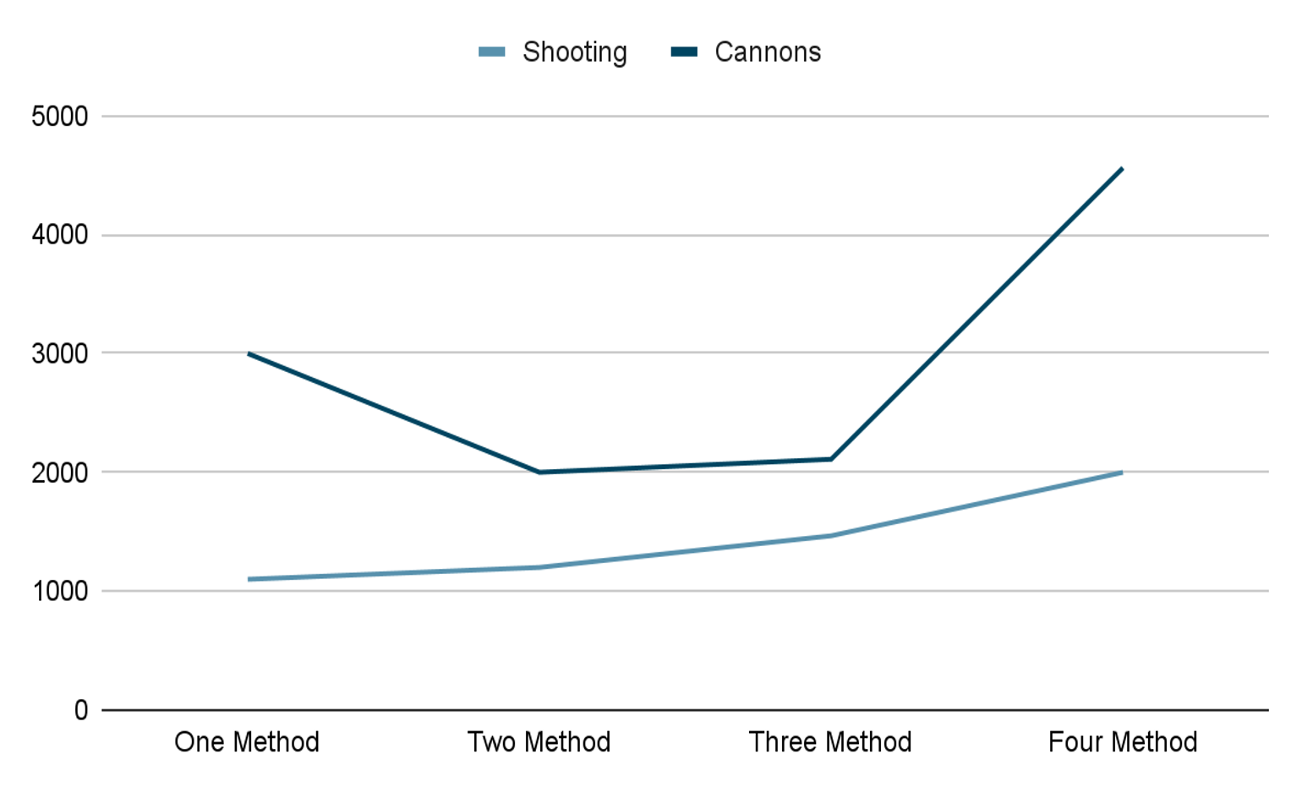
Shooting, Cannon

Slide 24
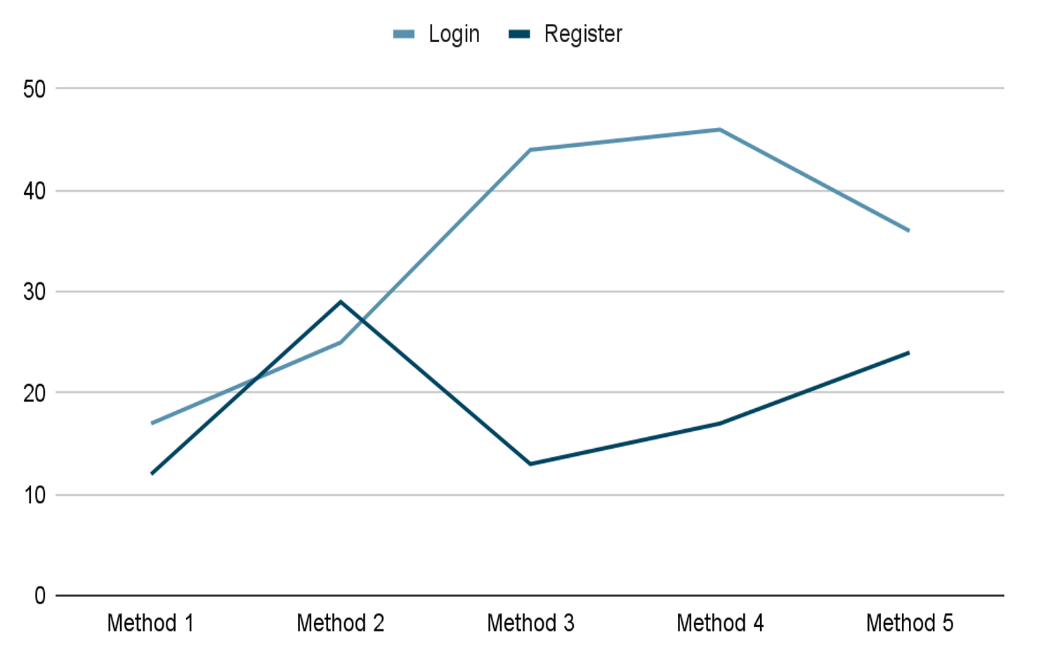
Login, Register

Slide 25
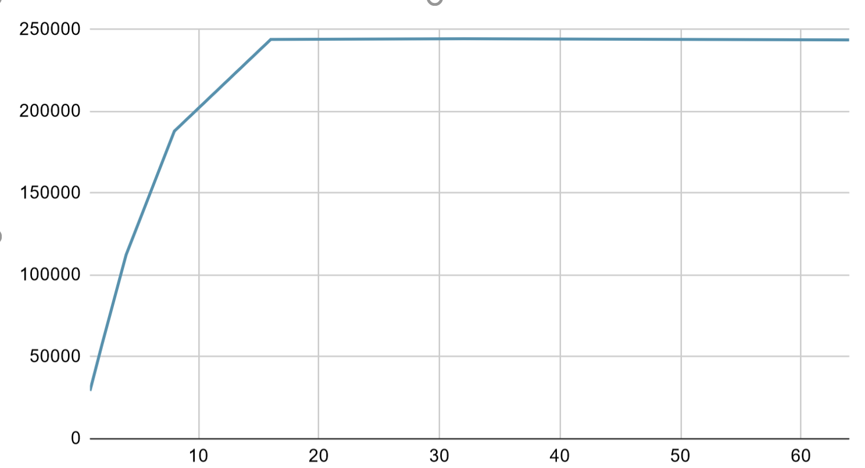
CPU performance

Slide 26
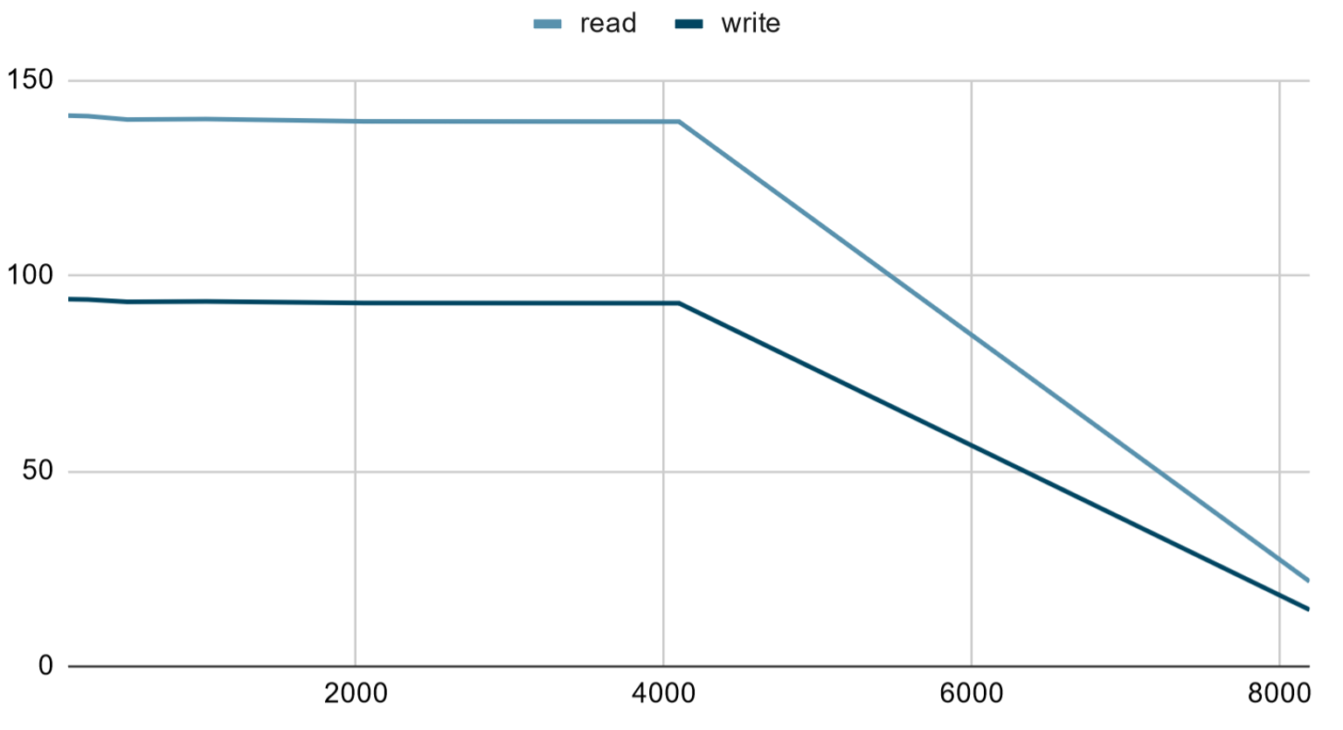
File I/O performance

Slide 27
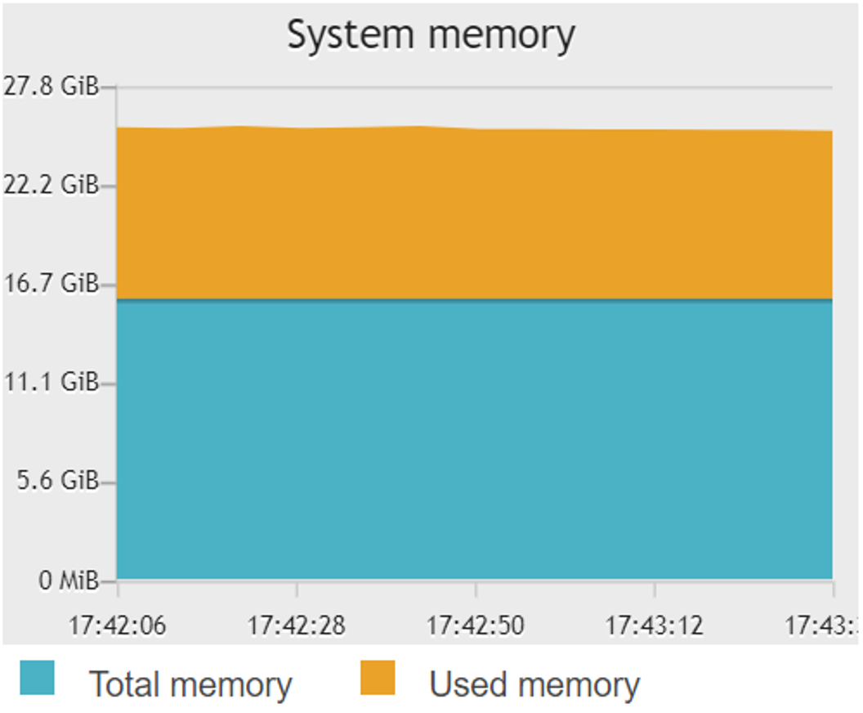
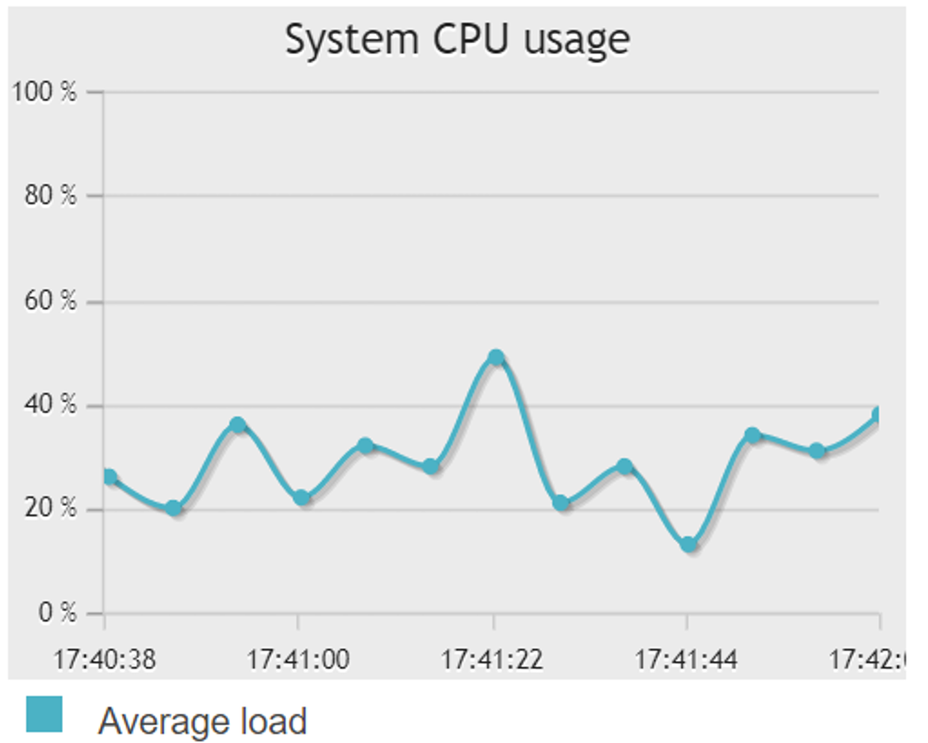
Database performance

Slide 28
Approach to HCI
User Interface Requirements
Mouse and Keyboard compatibility
Login and signup features using text fields and buttons
Game played primarily through WASD and Arrow keys
In game pause menu
Iterative Process for Updating User Interface
Camera focuses on player character until x threshold is crossed
Bullets are killed once they go out of Camera view
The main menu is updated through scene changes by button clicks

Slide 29
Approach to Static and Dynamic Testing
Static Testing Strategy
Code review
During our team meetings at the library we have removed 4 scripts that were either not needed or not filled out. Ex. Health.cs, Quit.cs, Startup.cs, and WallCannon.cs.
We also cleaned up the code in our scripts by removing/modifying methods/variables in our scripts.
Dynamic Testing Strategy
Black-Box Testing - Boundary Analysis
The tests involving our database logging in function requires at least 8 characters.
White-Box Testing - Basis Path
Our unit tests have diagrams attached that demonstrate the cyclomatic complexity. Bullet.cs’s update() method has a CC of 6 while our OnCollisionEnter2D() in player.cs has a CC of 3.

Slide 30
What we learned
How to manage/share files while working in a team.
How to solve a problem as a team.
How to distribute work among the team members.
How to decide who gets what work according to their strengths.
How to work around other team members schedule.

Slide 31
Potential work
Implement more enemies
Create more interactive player character
Implement health feature
Create a version for mac

